Slide 1
Learning Objective
I will be able to define geometric sequence given a rule.
Success Criteria
At the end of the lesson, I will be able to:
define a geometric sequence recursively and in terms of a common ratio;
list terms of a geometric sequence given a rule;
write the recursive rule for a geometric sequence given terms;
derive the general (explicit) rule for a geometric sequence and make the connection to exponential relationships;
find the nth term of a geometric sequence;
given two terms of a geometric sequence, find the common ratio, first term and hence rules; and
verify whether a given value is part of a geometric sequence.

Slide 2
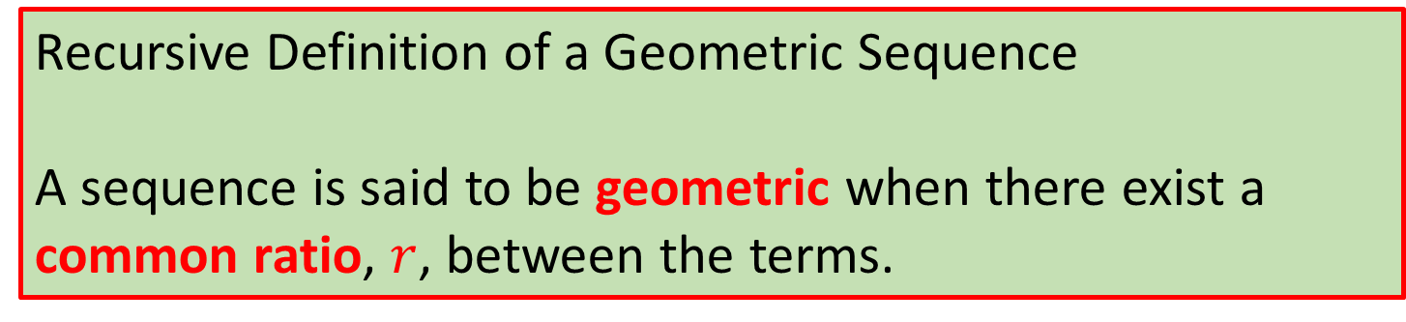
Skill Development
Sequence 1:
{3, 6, 9, 12, 15, 18, …}
Sequence 2:
{3, 6, 12, 24, 48, 96, …}
Common difference of 3
Arithmetic Sequence
Common ratio of 2
Geometric Sequence
Recursive Definition of a Geometric Sequence
A sequence is said to be geometric when there exist a common ratio, $r$, between the terms.

Slide 3
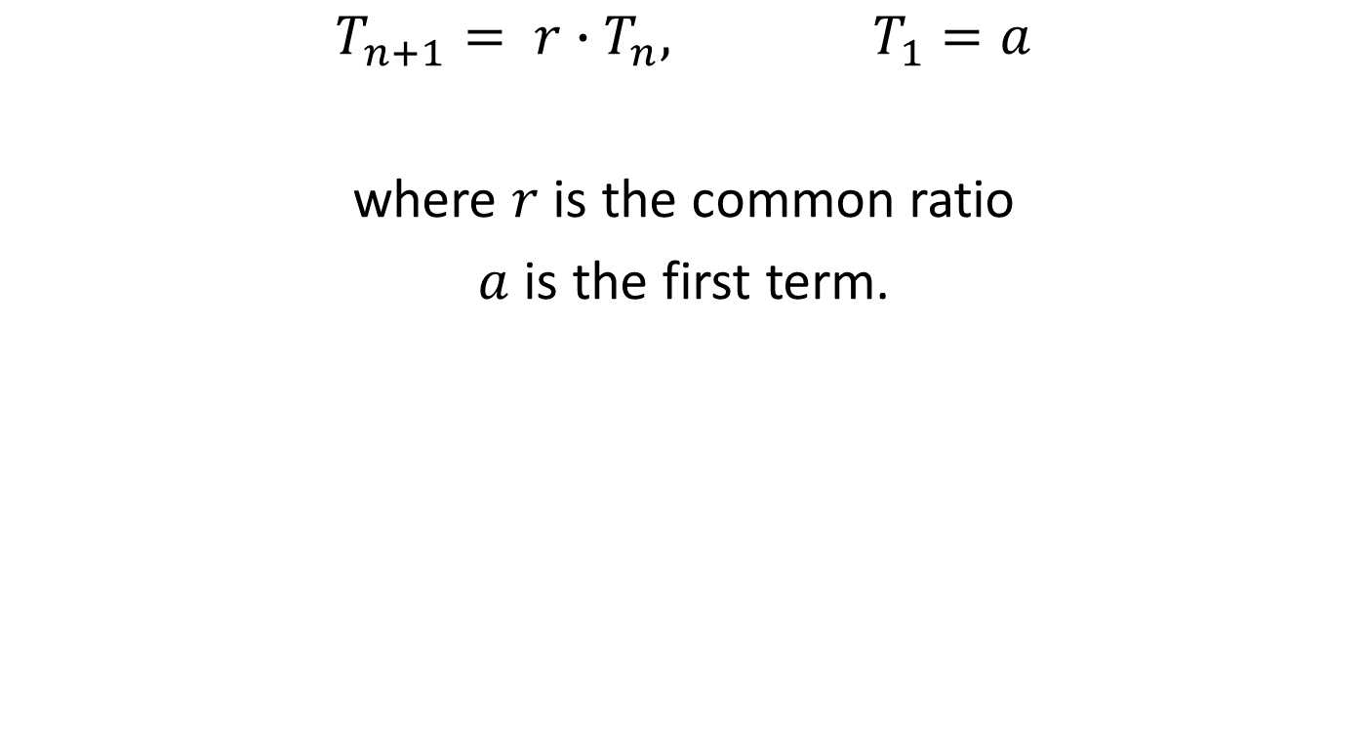
Recursive Rule of a geometric sequence
Concept Development
$$T_{n+1}= {r∙T}_{n}, T_{1}=a$$
where $r$ is the common ratio
$a$ is the first term.

Slide 4
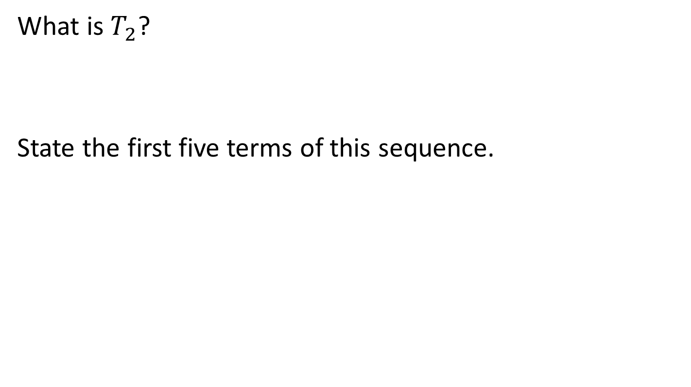



Consider: $T_{n+1}={3T}_{n}, T1 =2$
Skill Development
What is $T_{2}$?
State the first five terms of this sequence.
$$T_{2}=3\left(T_{1}\right)=3\left(2\right)=6$$
$$3, 6, 18, 54, 162$$

Slide 5
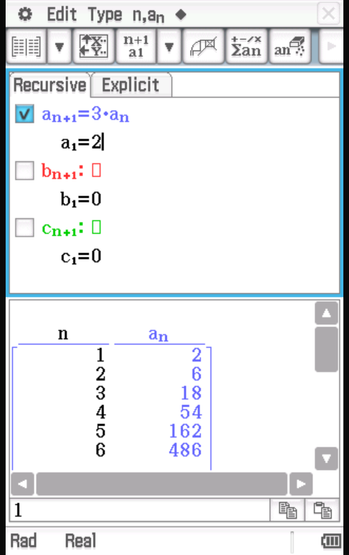
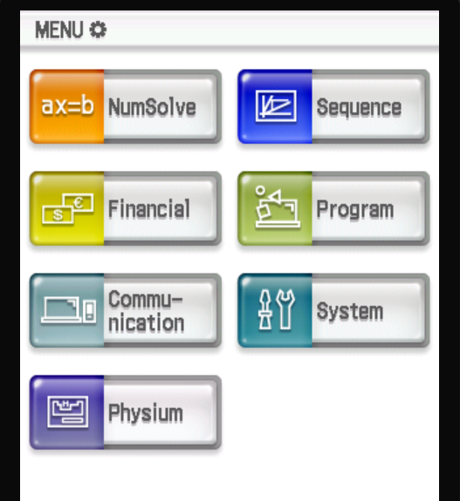
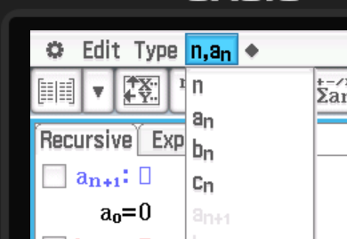
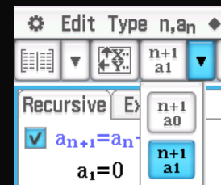
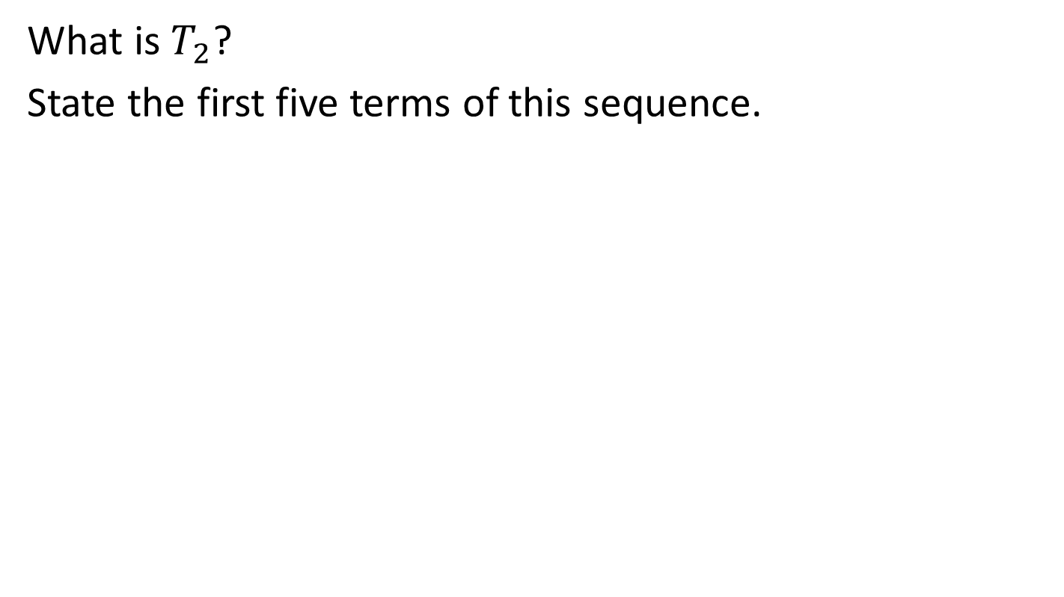

ClassPad
Consider: $T_{n+1}={3T}_{n}, T1 =2$
What is $T_{2}$?
State the first five terms of this sequence.

Slide 6
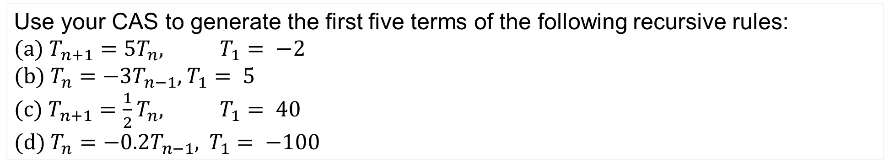
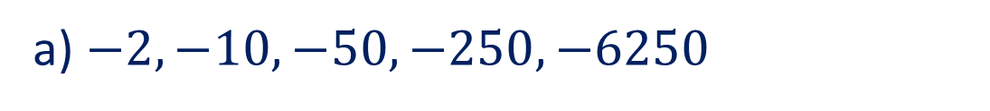
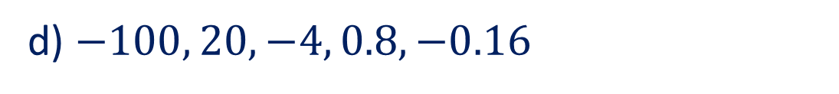
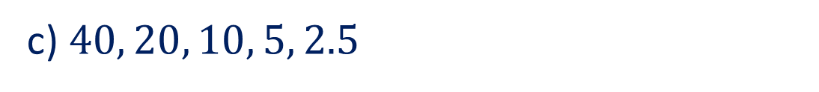
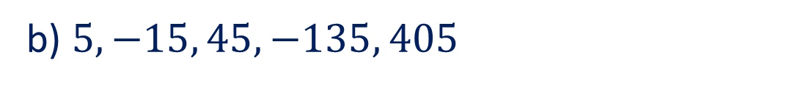
Guided Practice
Use your CAS to generate the first five terms of the following recursive rules:
(a) $T_{n+1}=5T_{n}$, $T_{1}= −2$
(b) $T_{n}=−3T_{n−1}$, $T_{1}= 5$
(c) $T_{n+1}=\frac{1}{2}T_{n}$, $T_{1}= 40$
(d) $T_{n}=−0.2T_{n−1}$, $T_{1}= −100$
a) $−2, −10, −50, −250, −6250$
b) $5, −15, 45, −135, 405$
c) $40, 20, 10, 5, 2.5$
d) $−100, 20, −4, 0.8, −0.16$

Slide 7

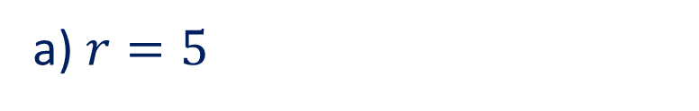
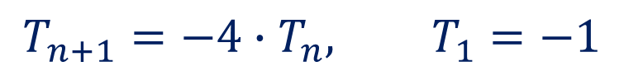
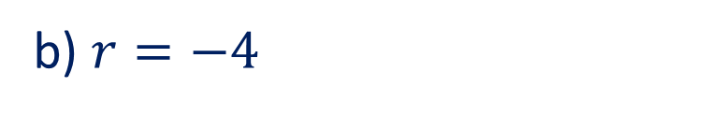

Guided Practice
Using the word description, write a recursive rule for the following geometric sequences.
(a) Starting from 3, the next term is given by multiplying the previous term by 5.
(b) Starting from -1, the next term is given by multiplying the previous term by -4.
a) $r=5$
$$T_{n+1}=r∙T_{n}, T_{1}=3$$
$$T_{n+1}=5∙T_{n}, T_{1}=3$$
b) $r=−4$
$$T_{n+1}=−4∙T_{n}, T_{1}=−1$$

Slide 8
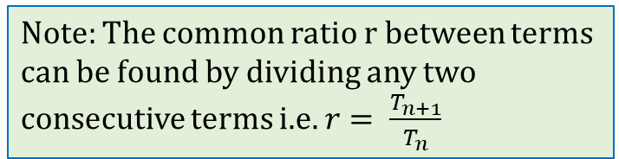


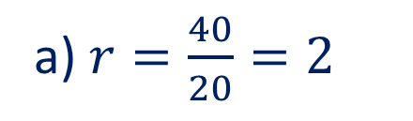
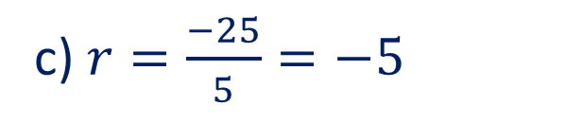
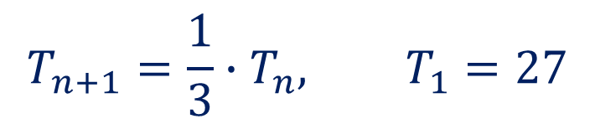
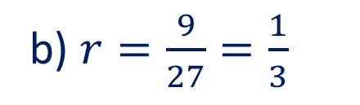
Guided Practice
For each of the following geometric sequences, write a recursive rule.
(a) {20, 40, 80, 160, …}
(b) {27, 9, 3, 1, …}
(c) {5, −25, 125, −625, …}
Note: The common ratio r between terms can be found by dividing any two consecutive terms i.e. $r= \frac{T_{n+1}}{T_{n}}$
a) $r=\frac{40}{20}=2$
$$T_{n+1}=2∙T_{n}, T_{1}=20$$
b) $r=\frac{9}{27}=\frac{1}{3}$
$$T_{n+1}=\frac{1}{3}∙T_{n}, T_{1}=27$$
c) $r=\frac{−25}{5}=−5$
$$T_{n+1}=−5∙T_{n}, T_{1}=5$$

Slide 9
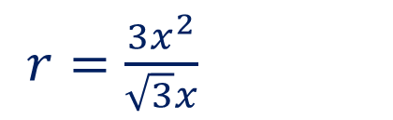

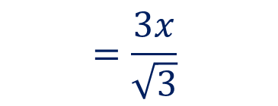
Guided Practice
Write a recursive rule for the following geometric sequence.
$\{\sqrt{3}x, 3x^{2}, 3\sqrt{3}x^{3},{9x}^{4}, …\}$
$r=\frac{3x^{2}}{\sqrt{3}x}$
$$=\frac{3x}{\sqrt{3}}$$
$$=\sqrt{3}x$$
$$T_{n+1}=\sqrt{3}x∙T_{n}, T_{1}=\sqrt{3}x$$

Slide 10
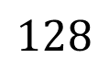
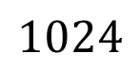


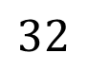

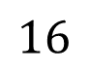
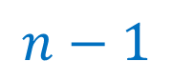
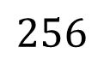
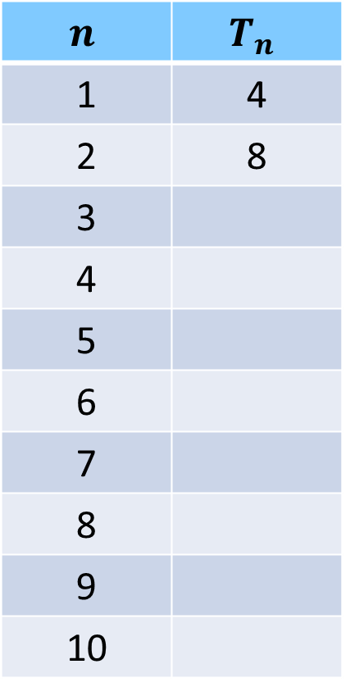
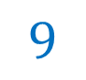
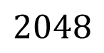

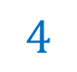

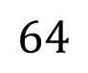
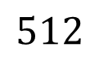
The General Rule (Explicit Rule) of the $n^{th}$ term
Concept Development
Consider $T_{n+1}={2T}_{n}, T1 =4$
$$n$$ | $$T_{n}$$
1 | 4
2 | 8
3
4
5
6
7
8
9
10
$$2$$
When we jumped to the 3rd term, we have to multiply by two ____ times.
When we jumped to the 5th term, we have to multiply by two ____ times.
When we jumped to the 10th term, we have to multiply by two ____ times.
When we jumped to the n^{th} term, we have to multiply by two ____ times.
So, the general rule is:
$$4$$
$$9$$
$$16$$
$$n−1$$
$$32$$
$$64$$
$$128$$
$$T_{n}=T_{1}∙2^{n−1}$$
$$256$$
$$512$$
$$T_{n}=4∙2^{n−1}$$
$$1024$$
$$2048$$

Slide 11
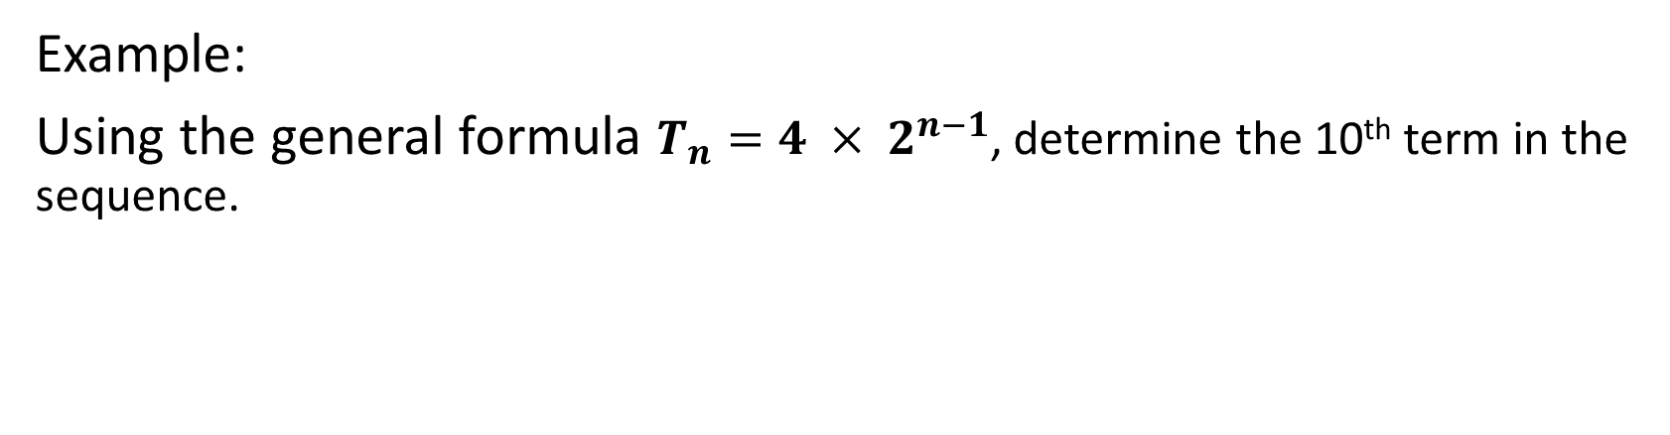
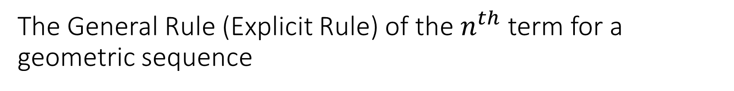


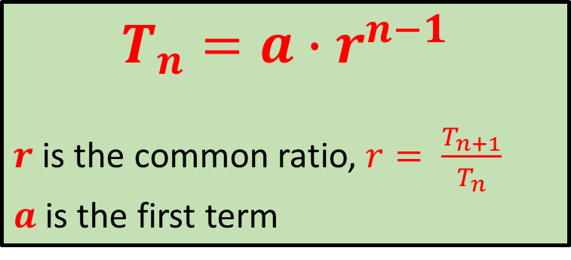
The General Rule (Explicit Rule) of the $n^{th}$ term for a geometric sequence
Concept Development
$$T_{n}=a∙r^{n−1}$$
$r$ is the common ratio, $r= \frac{T_{n+1}}{T_{n}}$
$a$ is the first term
Example:
Using the general formula $T_{n}=4 × 2^{n−1}$, determine the 10th term in the sequence.
$$T_{10}=4×2^{10−1}$$
$$T_{10}=2048$$

Slide 12
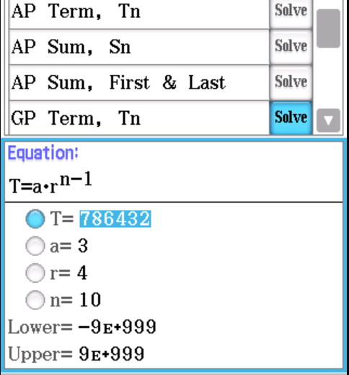
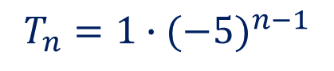
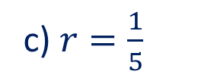

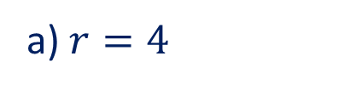
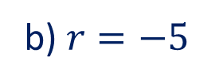
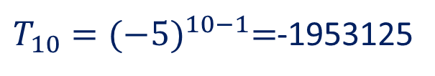
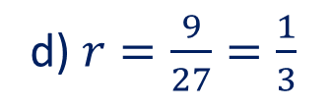
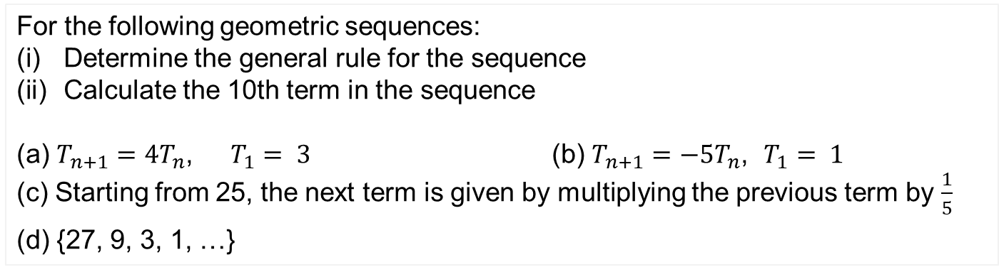




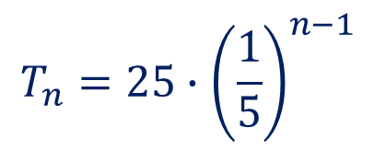
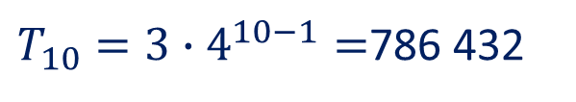
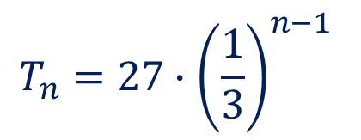



Guided Practice
For the following geometric sequences:
Determine the general rule for the sequence
Calculate the 10th term in the sequence
(a) $T_{n+1}=4T_{n}$, $T_{1}= 3$ (b) $T_{n+1}=−5T_{n}$, $T_{1}= 1$
(c) Starting from 25, the next term is given by multiplying the previous term by $\frac{1}{5}$
(d) {27, 9, 3, 1, …}
$$T_{n}=a∙r^{n−1}$$
c) $r=\frac{1}{5}$
$$a=25$$
$$a=3$$
$$T_{n}=25∙{\left(\frac{1}{5}\right)}^{n−1}$$
a) $r=4$
$$T_{n}=3∙4^{n−1}$$
$$T_{10}=1.28×{10}^{−5}$$
$T_{10}=3∙4^{10−1}=$786 432
d) $r=\frac{9}{27}=\frac{1}{3}$
$$a=27$$
b) $r=−5$
$$a=1$$
$$T_{n}=27∙{\left(\frac{1}{3}\right)}^{n−1}$$
$$T_{n}=1∙{(−5)}^{n−1}$$
$T_{10}={(−5)}^{10−1}=$-1953125
$$T_{10}=1.37×{10}^{−3}$$

Slide 13
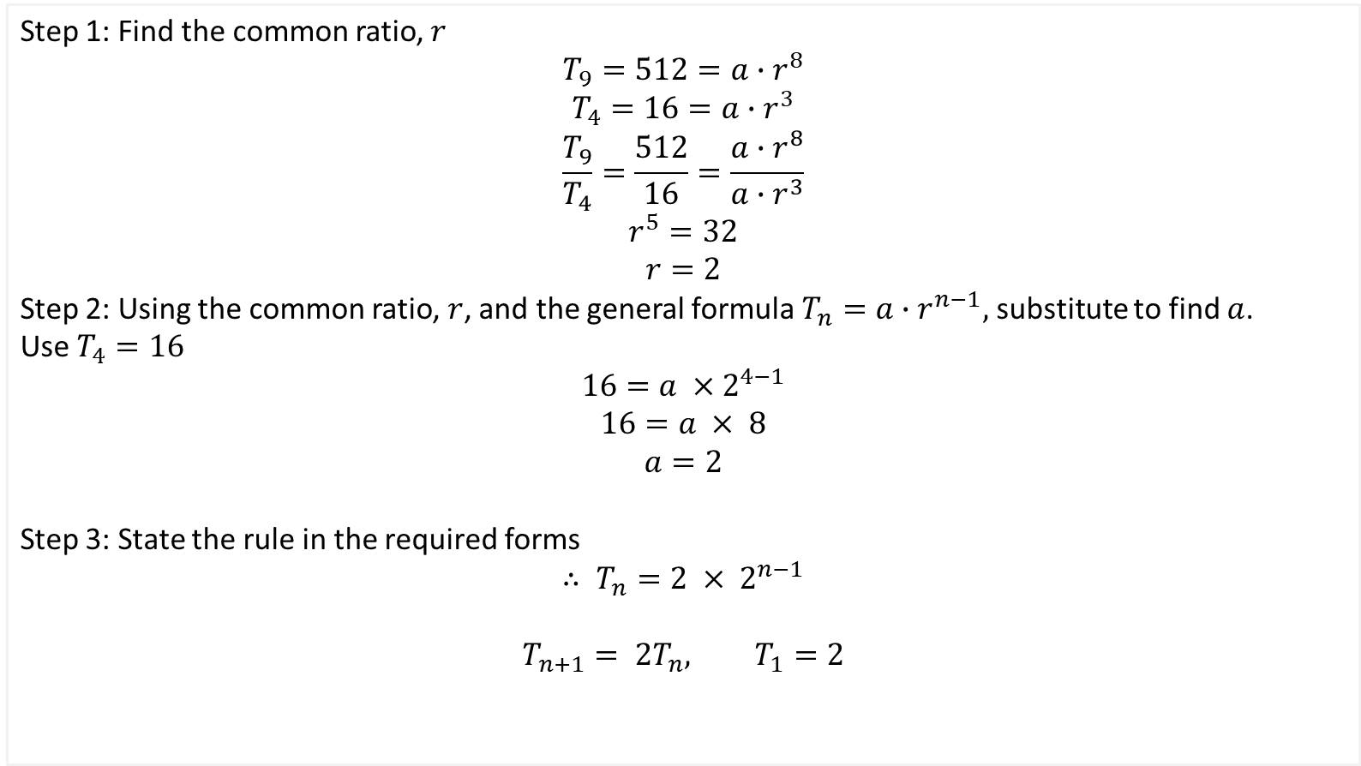
Guided Practice
If the 9th term of a sequence is 512 (i.e. $T_{9}=512)$ and the 4th term is 16 (i.e. $T_{4}=16$). State the general and recursive rule of this geometric sequence.
Step 1: Find the common ratio, $r$
$$T_{9}=512=a∙r^{8}$$
$$T_{4}=16=a∙r^{3}$$
$$\frac{T_{9}}{T_{4}}=\frac{512}{16}=\frac{a∙r^{8}}{a∙r^{3}}$$
$$r^{5}=32$$
$$r=2$$
Step 2: Using the common ratio, $r$, and the general formula $T_{n}=a∙r^{n−1},$ substitute to find $a$.
Use $T_{4}=16$
$$16=a ×{ 2}^{4−1}$$
$$16=a × 8$$
$$a=2$$
Step 3: State the rule in the required forms
$$∴ T_{n}=2 × 2^{n−1}$$
$$T_{n+1}= {2T}_{n}, T_{1}=2$$

Slide 14

Finding the rules from two terms
Skill Development
If the 9th term of a sequence is 512 (i.e. $T_{9}=512)$ and the 4th term is 16 (i.e. $T_{4}=16$). State the general and recursive rule of this geometric sequence.
Let these two terms be $T_{m}=b$, and $T_{n}=a$
From the general rule,
$T_{m}=a ×{ r}^{m−1}$, $T_{n}=a ×{ r}^{n−1}$
To find $r,$ use $\frac{T_{m}}{T_{n}}=\frac{a ×{ r}^{m−1}}{a ×{ r}^{n−1}}=\frac{r^{m−1}}{r^{n−1}}$
Hence
$r^{m−n}=\frac{b}{a}$

Slide 15

Concept Development
OTHER USEFUL FORMULA (TO DETERMINE FUTURE TERMS IN A SEQUENCE)
Obtaining a value for $a$ (knowing $r$)
$$a= \frac{T_{n}}{r^{n−1}}$$
Obtaining a value for $r$ (knowing $a$)
$$r={\left(\frac{T_{n}}{a}\right)}^{\frac{1}{n−1}}$$
NOTE: Calculating the value of n is beyond the level of this course.

Slide 16










Guided Practice
Find the 20th term of the geometric sequence with $T_{2}=10$ and $T_{5}=−80$.
$$10=a∙r^{1}$$
$$−80=a∙r^{4}$$
$$\frac{r^{4}}{r^{1}}=−\frac{80}{10}$$
$$r^{3}=−8$$
$$r=−2$$
$$10=a\left(−2\right)$$
$$a=−5$$
$$T_{n}=−5∙{\left(−2\right)}^{n−1}$$
$$T_{20}=−5∙{\left(−2\right)}^{n−1}$$
$$=2621440$$

Slide 17






Guided Practice
A geometric sequence has a first term of 3 and a 20th term of 1 572 864. Find the common ratio and hence state a general rule for the sequence.
$$a=3$$
$$1 572864=3∙r^{19}$$
$$524,288=r^{19}$$
$$r={\left(524 288\right)}^{\frac{1}{19}}$$
$$r=2$$
$$T_{n}=3×2^{n−1}$$

Slide 18








Guided Practice
Consider the following geometric sequence: {𝑥 + 1, 3𝑥 + 3, 10𝑥 + 5, …}.
Determine the value of $x$.
$$r=\frac{3x+3}{x+1}$$
$$r=\frac{3(x+1)}{x+1}$$
$$r=3$$
$$r=\frac{10x+5}{3x+3}$$
$$3=\frac{10x+5}{3x+3}$$
$$9x+9=10x+5$$
$$3\left(3x+3\right)=10x+5$$
$$x=4$$

Slide 19








Guided Practice
For a geometric sequence {36, 18, 9, … }, the $n$^{th} term is $\frac{9}{16}$. Find the value of $n$.
$$a=36$$
$$r=\frac{18}{36}=\frac{1}{2}$$
$$T_{n}=\frac{9}{16}=36∙{\left(\frac{1}{2}\right)}^{n−1}$$
$$\frac{9}{16×36}={\left(\frac{1}{2}\right)}^{n−1}$$
$$\frac{1}{16×4}={\left(\frac{1}{2}\right)}^{n−1}$$
$${\left(\frac{1}{2}\right)}^{6}={\left(\frac{1}{2}\right)}^{n−1}$$
$$\frac{1}{64}={\left(\frac{1}{2}\right)}^{n−1}$$
$$6=n−1 \\ n=7$$

Slide 20











Guided Practice
Georgina draws a pattern consisting of a number of equilateral triangles. The first triangle has sides of length 4cm and the side length of each successive triangle is one and a half times of the side length of the previous one.
What is the side length of the fifth triangle? Give your answers in exact value.
Which triangle has a side length of $45\frac{9}{16}$ cm
$$T_{n}=45\frac{9}{16}=4∙{\left(\frac{3}{2}\right)}^{n−1}$$
$$a=4, r=\frac{3}{2}$$
$$\frac{729}{16}=4∙{\left(\frac{3}{2}\right)}^{n−1}$$
$$T_{n}=4∙{\left(\frac{3}{2}\right)}^{n−1}$$
$$\frac{729}{64}={\left(\frac{3}{2}\right)}^{n−1}$$
$$T_{5}=4∙{\left(\frac{3}{2}\right)}^{5−1}=\frac{81}{4}=20\frac{1}{4}$$
$${\left(\frac{3}{2}\right)}^{n−1}={\left(\frac{3}{2}\right)}^{6}$$
The fifth triangle has a side length of $20\frac{1}{4}$ cm
The 7th triangle has a side length of $45\frac{9}{16}$
$$n−1=6 \\ n=7$$

Slide 21

Concept Development
Compound Interest: Interest calculated at regular intervals, on the Principal and interest accumulated in the previous years.
Assume that $1000 is invested at the start of the year for 10% per annum.
At the end of the first year, the amount will have grown to
$1000+0.1 (1000)=\$1100$
At the end of the second year, the amount will have grown to
$(1000+\left(0.1\right)\left(1000\right))+0.1(1000+\left(0.1\right)\left(1000\right))=\$1210$
The rule to determine the value of investment at the end of each year:
Initial amount $a=1000$
Common ratio $r=1.1$
$$T_{n}=1000∙{\left(1.1\right)}^{n−1}$$

Slide 22





Guided Practice
Marta invests $2500 at 7% p.a. compounded annually. Find:
The value of her investment after 5 years
How long does it takes until her investment is worth $10000
$$a=2500, r=1.07$$
$$T_{n}=\$10000=2500∙{\left(1.07\right)}^{n−1}$$
$$T_{n}=2500∙{\left(1.07\right)}^{n−1}$$
Use CAS to solve: $10000=2500∙{\left(1.07\right)}^{n−1}$
Where $T_{n}$ is the value at the end of ${\left(n−1\right)}^{th}$ year
$$T_{6}=2500∙{\left(1.07\right)}^{6−1}$$
$$T_{6}=\$3506.38$$
Use CAS to solve: $n=21.49$
By the end of 21st year, the investment will be worth over $10000

Slide 23


The geometric mean of 2 numbers $a, b$ is defined as
Skill Development
$$\sqrt{ab}$$
Example:
Find the geometric mean of 5 and 720
$$\sqrt{5\left(720\right)}=60$$

Slide 24








Guided Practice
Download and Load APII and GP II on CLASSPAD
The third term of a geometric sequence is 10 and the sixth term is 80. Find the common ratio and hence state a general rule for the sequence.
$T_{3}=10=ar^{2}$ --(1)
$T_{6}=80=ar^{5}$ --(2)
$$\frac{(2)}{(1)}, 8=r^{5}$$
$$r=2$$
$$10=a{\left(2\right)}^{2}$$
$$a=\frac{5}{2}$$
$$T_{n}=\frac{5}{2}∙2^{n−1}$$

Slide 25





The 12th term of an arithmetic sequence is 9 and the 25th term is 100. Find $a$ and $d$ and hence find the 8th term.
Guided Practice
$$T_{12}=9=a+d\left(12−1\right)−−−\left(1\right)$$
$$T_{25}=100=a+d\left(25−1\right)−−−(2)$$
$$\left(2\right)−\left(1\right), 91=13d$$
$$d=7$$
$$9=a+7(11)$$
$$a=−68$$
$$T_{n}=−68+7(n−1)$$
$$T_{8}=−68+7(7)$$
$$T_{8}=−19$$

Slide 26
Independent Practice
Complete Cambridge Ex 15D

